Slide 1
Confidence intervals for proportions

Slide 2
Introduction
Proportions/rates as research question of interest
  Disease prevalence in populations
  Treatment success rates in clinical trials
  Diagnostic test sensitivity and specificity
  Adverse event rates in pharmaceutical studies
  Survey response rates in epidemiological studies

Slide 3
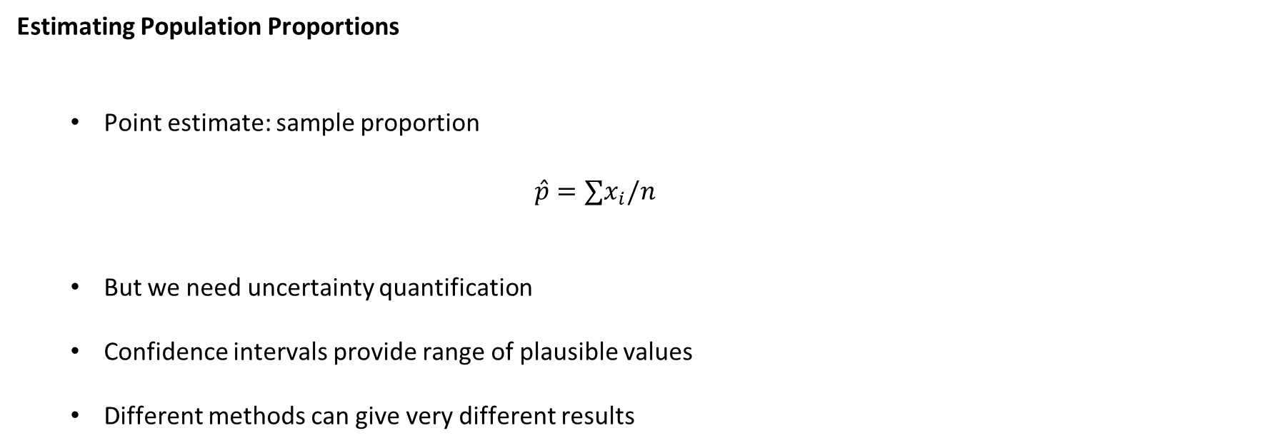
Introduction
Estimating Population Proportions
  Point estimate: sample proportion
    $$\hat{p}=∑x_{i}/n$$
  But we need uncertainty quantification
  Confidence intervals provide range of plausible values
  Different methods can give very different results

Slide 4
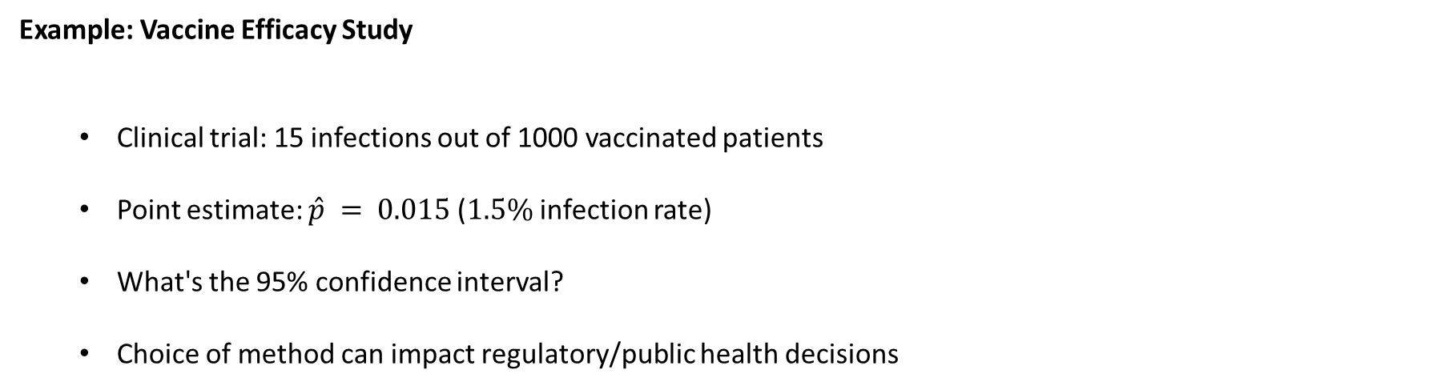
Introduction
Example: Vaccine Efficacy Study
  Clinical trial: 15 infections out of 1000 vaccinated patients
  Point estimate: $\hat{p} = 0.015$($1.5\%$ infection rate)
  What's the 95% confidence interval?
  Choice of method can impact regulatory/public health decisions

Slide 5
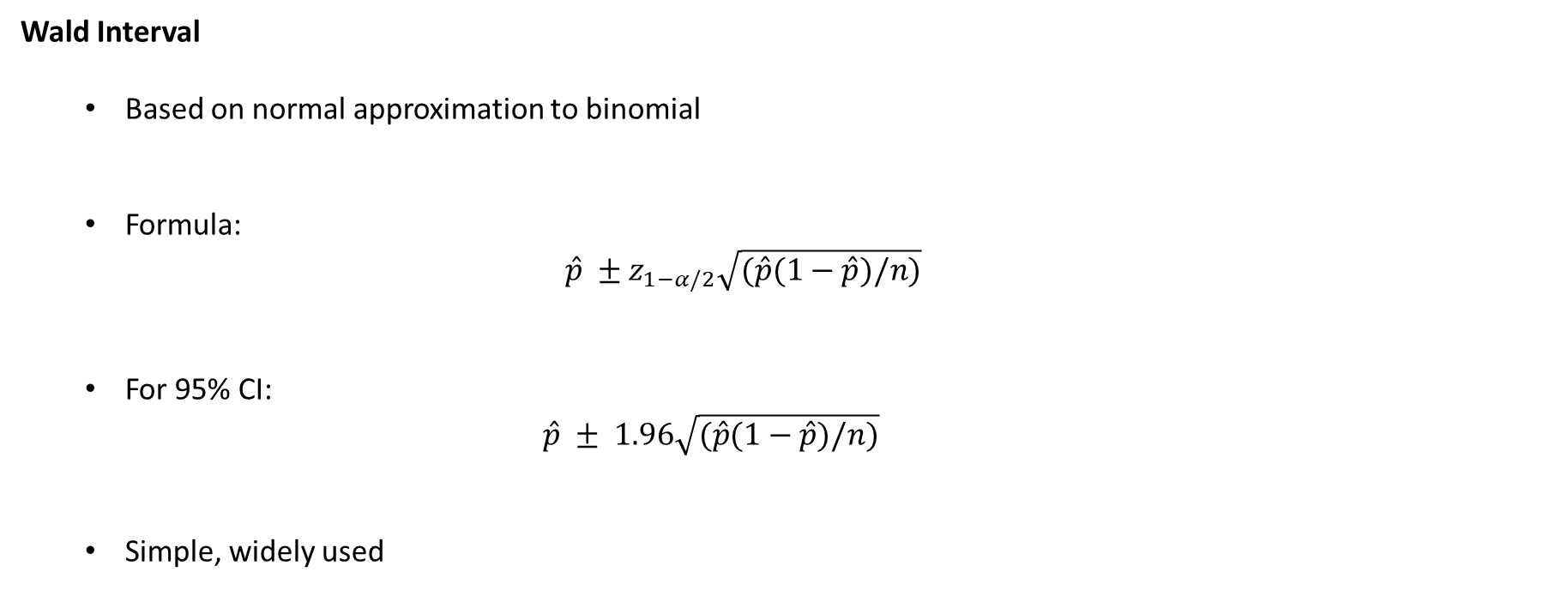
Wald-Type Confidence Interval
Wald Interval
  Based on normal approximation to binomial
  Formula:
  $$\hat{p} ±z_{1−α/2}\sqrt{(\hat{p}(1−\hat{p})/n)}$$
  For 95% CI:
    $$\hat{p} ± 1.96\sqrt{(\hat{p}(1−\hat{p})/n)}$$
  Simple, widely used

Slide 6
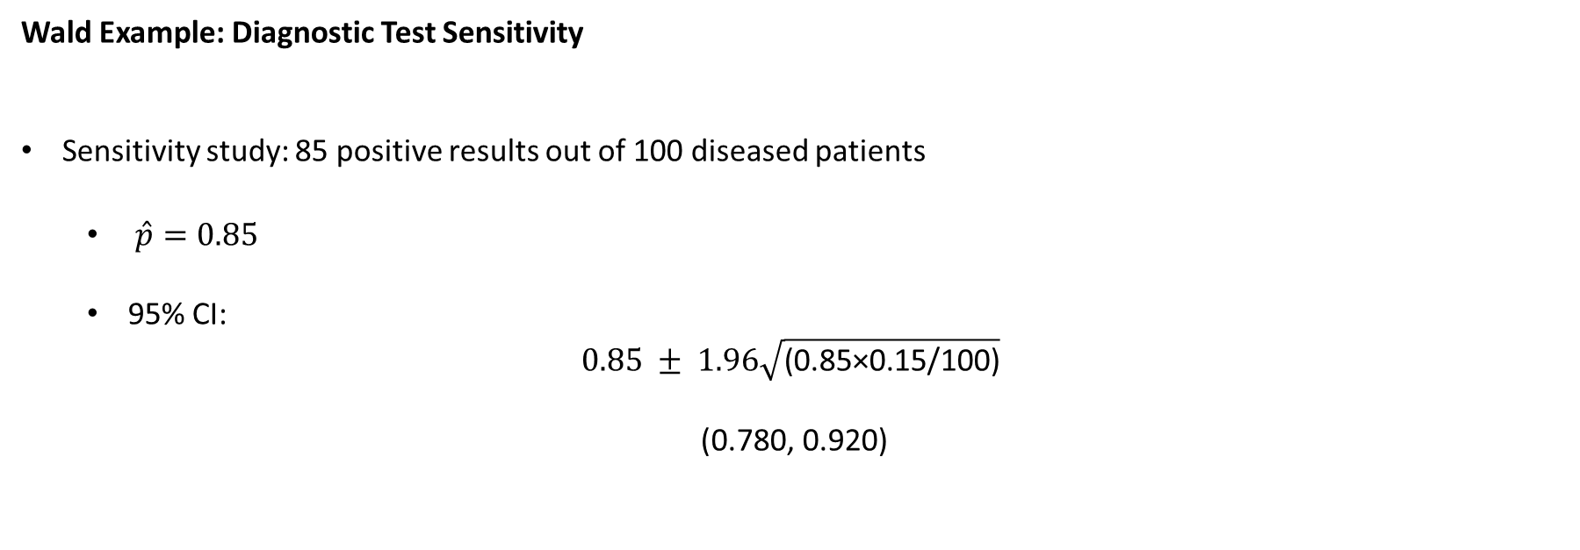
Wald-Type Confidence Interval
Wald Example: Diagnostic Test Sensitivity
Sensitivity study: 85 positive results out of 100 diseased patients
  $\hat{p}=0.85$
  95% CI:
$$0.85 ± 1.96\sqrt{\text{(0.85×0.15/100)}}$$

Slide 7
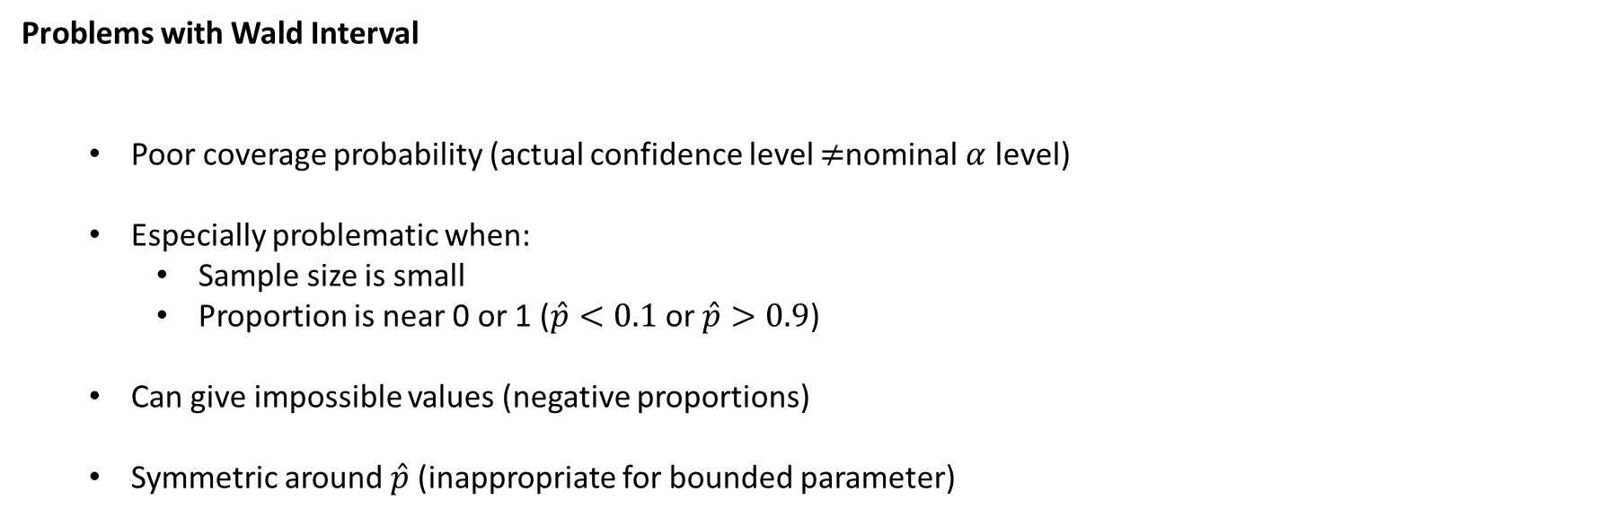
Wald-Type Confidence Interval
Problems with Wald Interval
  Poor coverage probability (actual confidence level $≠$nominal $α$ level)
  Especially problematic when:
    Sample size is small
    Proportion is near 0 or 1 ($\hat{p}<0.1$ or $\hat{p}>0.9$)
  Can give impossible values (negative proportions)
  Symmetric around $\hat{p}$ (inappropriate for bounded parameter)

Slide 8
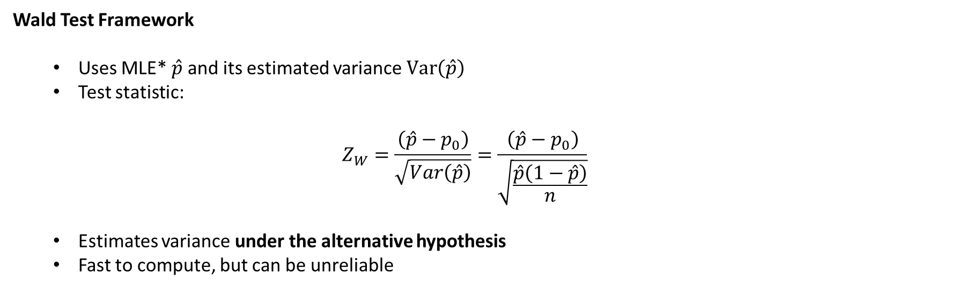
Score Tests vs Wald Tests
Wald Test Framework
  Uses MLE* $\hat{p}$ and its estimated variance $Var\left(\hat{p}\right)$
  Test statistic:
  $$Z_{W}=\frac{\left(\hat{p}−p_{0}\right)}{\sqrt{Var\left(\hat{p}\right)}}=\frac{\left(\hat{p}−p_{0}\right)}{\sqrt{\frac{\hat{p}\left(1−\hat{p}\right)}{n}}}$$
  Estimates variance under the alternative hypothesis
  Fast to compute, but can be unreliable
MLE*: maximum likelihood estimator
More on this next semester…

Slide 9
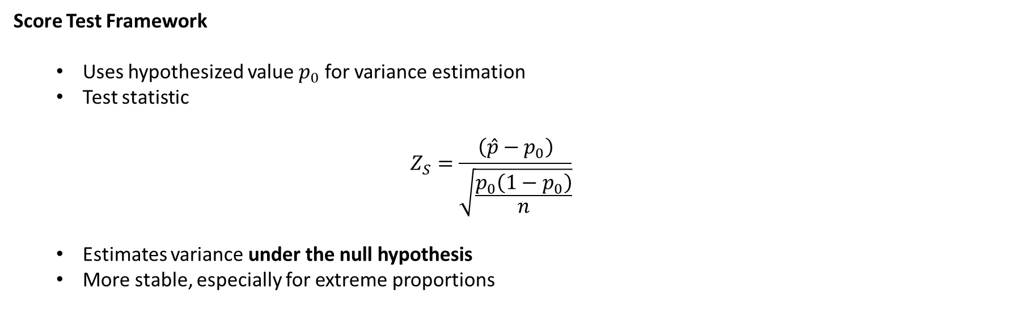
Score Tests vs Wald Tests
Score Test Framework
  Uses hypothesized value $p_{0}$ for variance estimation
  Test statistic
  $$Z_{S}=\frac{\left(\hat{p}−p_{0}\right)}{\sqrt{\frac{p_{0}\left(1−p_{0}\right)}{n}}}$$
  Estimates variance under the null hypothesis
  More stable, especially for extreme proportions

Slide 10
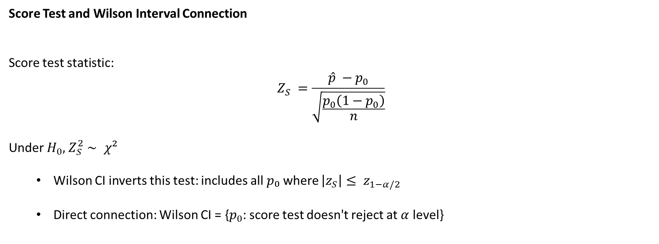
Score Tests vs Wald Tests
Score Test and Wilson Interval Connection
Score test statistic:
$$Z_{S} =\frac{\hat{p} −p_{0}}{\sqrt{\frac{p_{0}\left(1−p_{0}\right)}{n}}}$$
Under $H_{0},$ $Z_{S}^{2}∼ χ²$
  Wilson CI inverts this test: includes all $p₀$ where $\left|z_{S}\right|≤ z_{1−α/2}$
  Direct connection: Wilson CI = {$p_{0}$: score test doesn't reject at $α$ level}

Slide 11
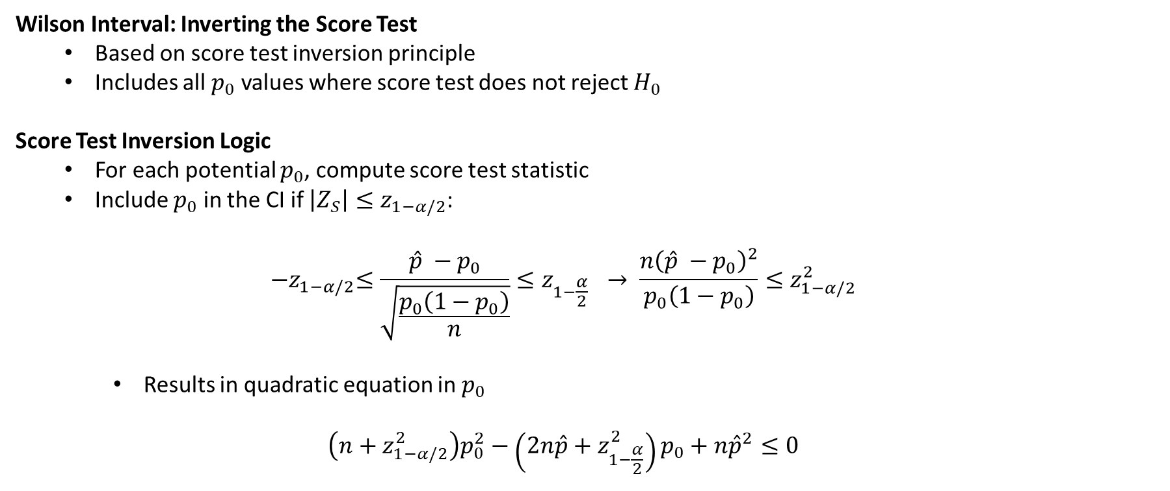
Wilson Score Interval
Wilson Interval: Inverting the Score Test
  Based on score test inversion principle
  Includes all $p_{0}$ values where score test does not reject $H_{0}$
Score Test Inversion Logic
  For each potential $p_{0}$, compute score test statistic
  Include $p_{0}$ in the CI if $\left|Z_{S}\right|≤z_{1−α/2}$:
  $${−z}_{1−α/2}≤\frac{\hat{p} −p_{0}}{\sqrt{\frac{p_{0}\left(1−p_{0}\right)}{n}}}≤z_{1−\frac{α}{2}} → \frac{{n\left(\hat{p} −p_{0}\right)}^{2}}{p_{0}\left(1−p_{0}\right)}≤z_{1−α/2}^{2}$$
    Results in quadratic equation in $p_{0}$
  $$\left(n+z_{1−α/2}^{2}\right)p_{0}^{2}−\left(2n\hat{p}+z_{1−\frac{α}{2}}^{2}\right)p_{0}+n{\hat{p}}^{2}≤0$$

Slide 12
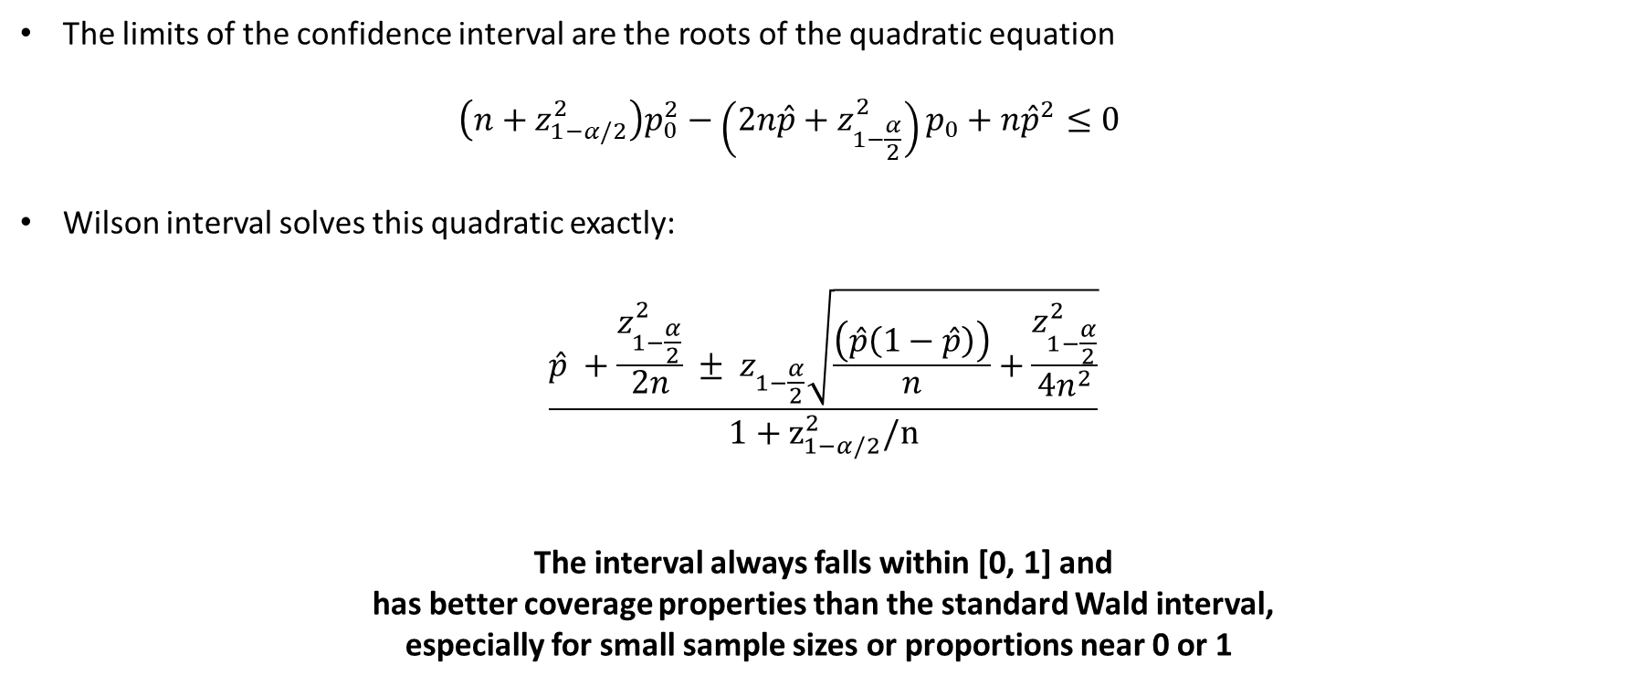
Wilson Score Interval
The limits of the confidence interval are the roots of the quadratic equation
  $$\left(n+z_{1−α/2}^{2}\right)p_{0}^{2}−\left(2n\hat{p}+z_{1−\frac{α}{2}}^{2}\right)p_{0}+n{\hat{p}}^{2}≤0$$
Wilson interval solves this quadratic exactly:
$$\frac{\hat{p} +\frac{z_{1−\frac{α}{2}}^{2}}{2n} ± z_{1−\frac{α}{2}}\sqrt{\frac{\left(\hat{p}\left(1−\hat{p}\right)\right)}{n}+\frac{z_{1−\frac{α}{2}}^{2}}{4n^{2}}}}{1+z_{1−α/2}^{2}/n}$$
The interval always falls within [0, 1] and
has better coverage properties than the standard Wald interval,
especially for small sample sizes or proportions near 0 or 1

Slide 13
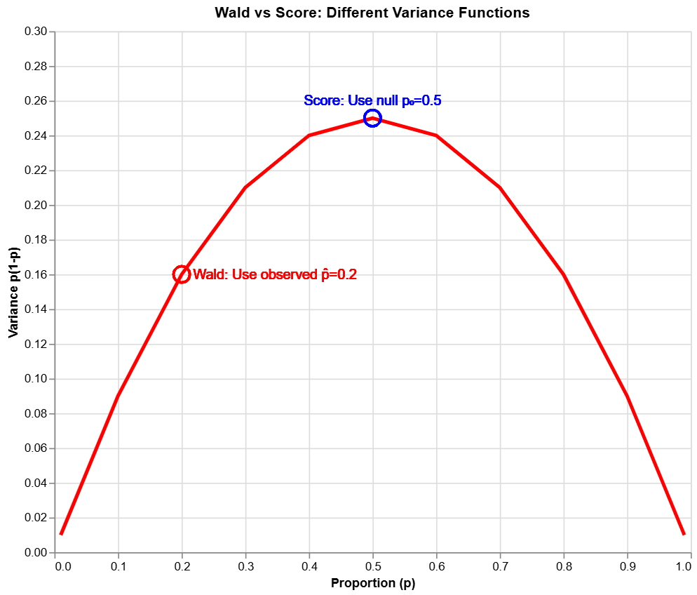
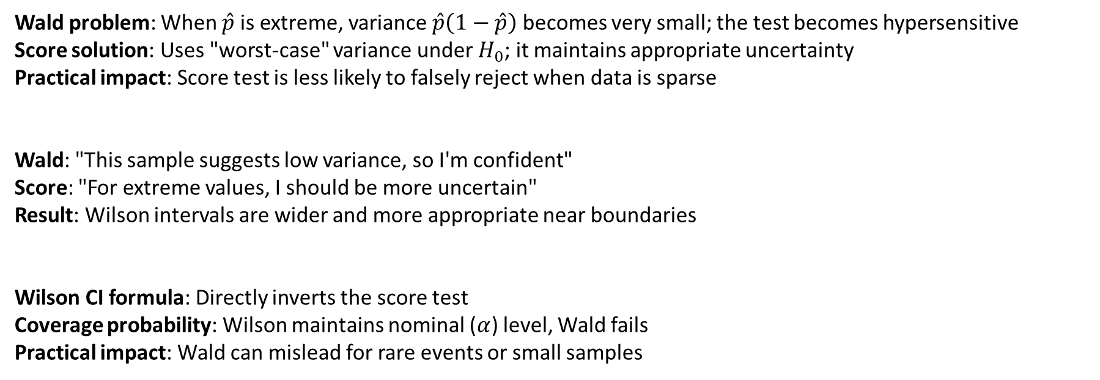
Wilson Score Interval
Wald problem: When $\hat{p}$ is extreme, variance $\hat{p}\left(1−\hat{p}\right)$ becomes very small; the test becomes hypersensitive
Score solution: Uses "worst-case" variance under $H_{0}$; it maintains appropriate uncertainty
Practical impact: Score test is less likely to falsely reject when data is sparse
Wald: "This sample suggests low variance, so I'm confident"
Score: "For extreme values, I should be more uncertain"
Result: Wilson intervals are wider and more appropriate near boundaries
Wilson CI formula: Directly inverts the score test
Coverage probability: Wilson maintains nominal ($α$) level, Wald fails
Practical impact: Wald can mislead for rare events or small samples

Slide 14
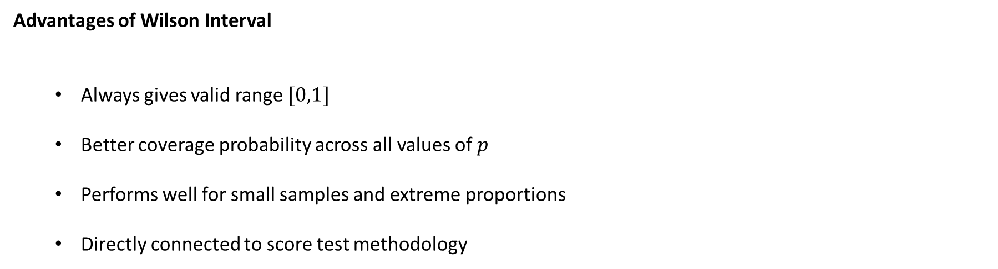
Wilson Score Interval
Advantages of Wilson Interval
  Always gives valid range $[0,1]$
  Better coverage probability across all values of $p$
  Performs well for small samples and extreme proportions
  Directly connected to score test methodology

Slide 15
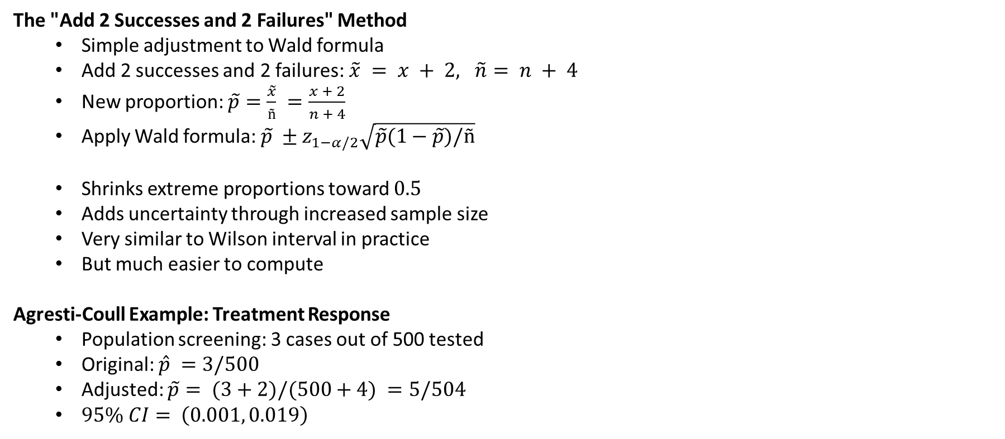
Agresti-Coull Interval
The "Add 2 Successes and 2 Failures" Method
  Simple adjustment to Wald formula
  Add 2 successes and 2 failures:$\tilde{x} = x + 2, \tilde{n}= n + 4$
  New proportion: $\tilde{p}=\frac{\tilde{x}}{ñ} =\frac{x + 2}{n + 4}$
  Apply Wald formula: $\tilde{p} ±z_{1−α/2}\sqrt{\tilde{p}(1−\tilde{p})/ñ}$
  Shrinks extreme proportions toward $0.5$
  Adds uncertainty through increased sample size
  Very similar to Wilson interval in practice
  But much easier to compute
Agresti-Coull Example: Treatment Response
  Population screening: 3 cases out of 500 tested
  Original: $\hat{p} =3/500$
  Adjusted: $\tilde{p}= (3+2)/(500+4) =5/504$
  $95\% CI= \left(0.001, 0.019\right)$

Slide 16
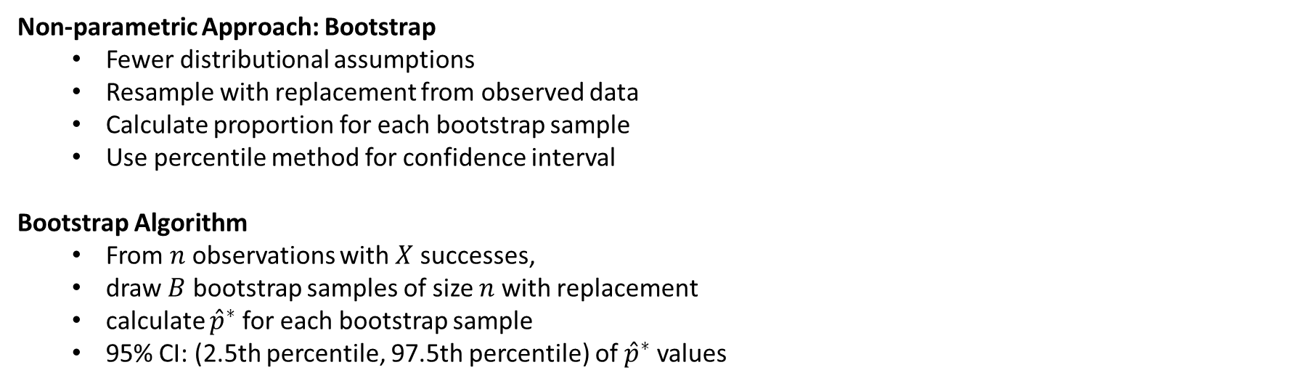
Bootstrap Confidence Intervals
Non-parametric Approach: Bootstrap
  Fewer distributional assumptions
  Resample with replacement from observed data
  Calculate proportion for each bootstrap sample
  Use percentile method for confidence interval
Bootstrap Algorithm
  From $n$ observations with $X$ successes,
  draw $B$ bootstrap samples of size $n$ with replacement
  calculate ${\hat{p}}^{∗}$ for each bootstrap sample
  95% CI: (2.5th percentile, 97.5th percentile) of ${\hat{p}}^{∗}$ values

Slide 17
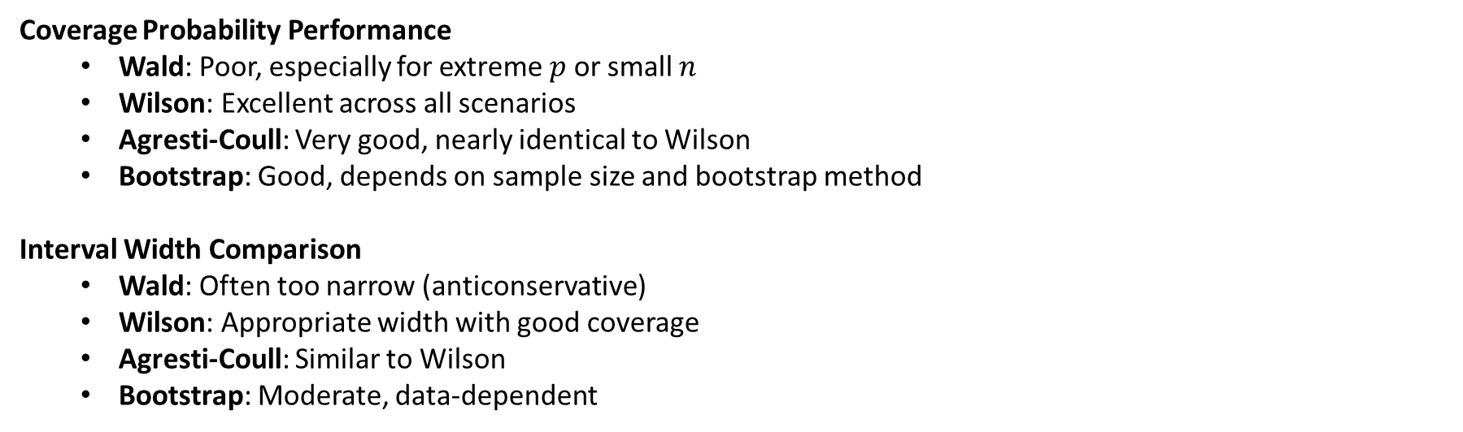
Comparison of Methods
Coverage Probability Performance
  Wald: Poor, especially for extreme $p$ or small $n$
  Wilson: Excellent across all scenarios
  Agresti-Coull: Very good, nearly identical to Wilson
  Bootstrap: Good, depends on sample size and bootstrap method
Interval Width Comparison
  Wald: Often too narrow (anticonservative)
  Wilson: Appropriate width with good coverage
  Agresti-Coull: Similar to Wilson
  Bootstrap: Moderate, data-dependent

Slide 18
Comparison of Methods
Computational Complexity
  Wald: Simplest (one formula)
  Agresti-Coull: Simple (adjusted Wald)
  Wilson: Moderate (quadratic formula)
  Bootstrap: Most intensive (requires resampling)
Practical Recommendations
  Avoid Wald for n < 30 or extreme proportions
  Use Wilson for better coverage, most situations
  Use Agresti-Coull for simplicity with good performance
  Use Bootstrap when distributional assumptions questionable

Slide 19
Conclusion
Score vs Wald Philosophy
  Score tests use null hypothesis for variance estimation
  Generally more robust and stable than Wald approaches
  Wilson interval directly inverts score test
Overall
  Wald interval: Simple but unreliable for small n or extreme p
  Wilson interval: widely recommended, very good coverage
  Agresti-Coull: Excellent compromise of simplicity and performance
  Bootstrap: Flexible but computationally intensive
Practical Guidelines
  Check sample size and proportion magnitude first
  Use Wilson or Agresti-Coull for most applications
  Always specify method in publications
  Consider computational resources available

Slide 20
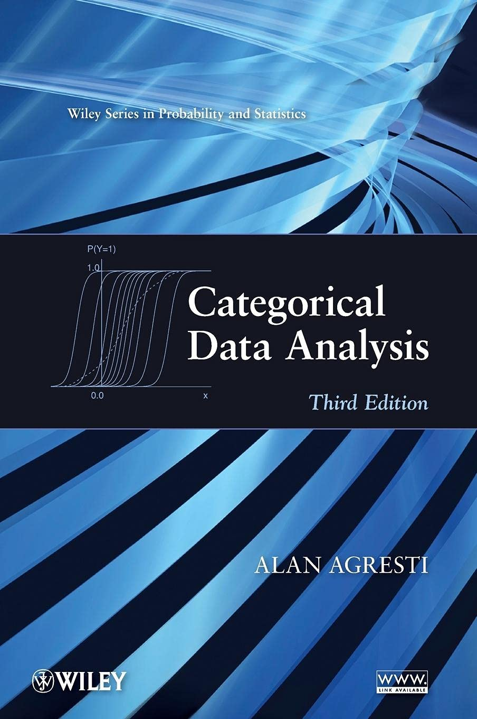
Conclusion
Statistical Inference:
  Point estimation (sample proportion)
  Interval estimation (confidence intervals) ← today's lecture
  Hypothesis testing (chi-square, Fisher's exact) ← last lecture
  Effect size quantification ← Previous lectures
  Multivariable modeling ← Regression framework (next semester)

Slide 21
THANK YOU!

